Slide 1
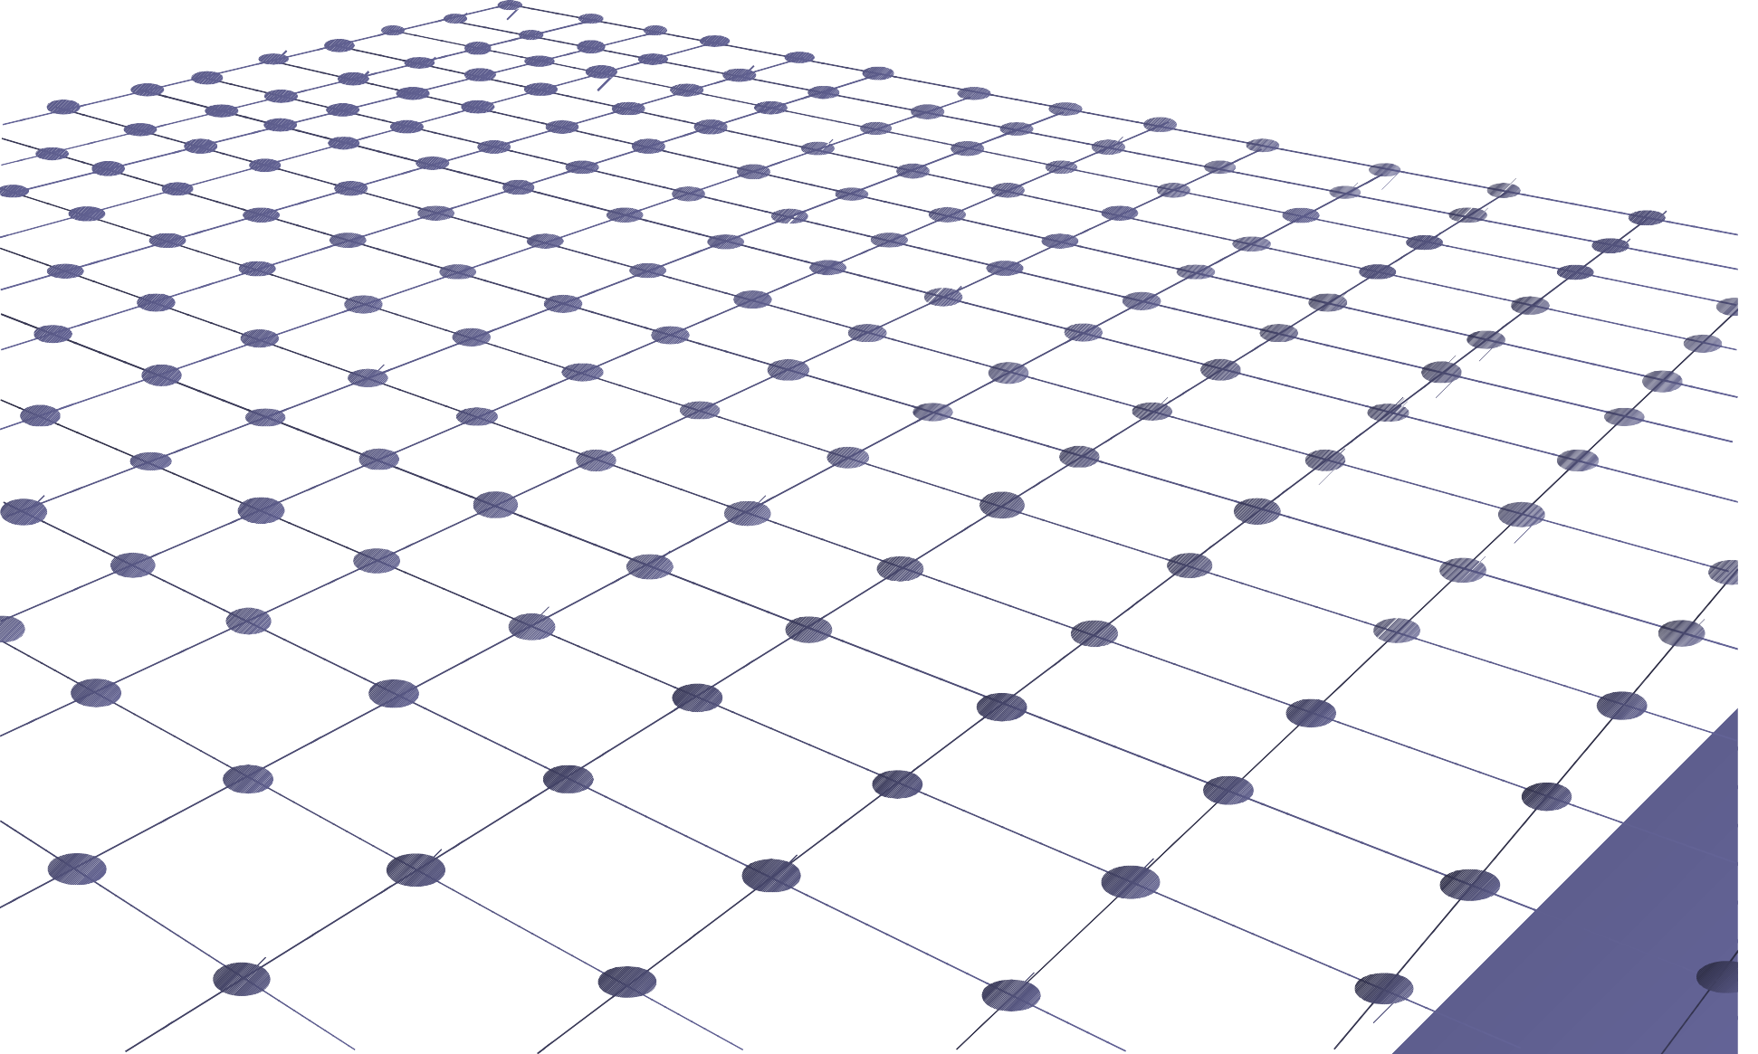
Binomial Coefficients
CS/APMA 202
Rosen section 4.4 Aaron Bloomfield

Slide 2
Binomial Coefficients
It allows us to do a quick expansion of (x+y)^{n}
Why it’s really important:
It provides a good context proofs
to present
■
Especially combinatorial proofs

Slide 3
Review: corollary 1
from section 4.3
Let n and r be non-negative integers with
r ≤ n. Then C(n,r) = C(n,n-r)
Or,
⎛ n ⎞ ⎛
n
⎞
⎜ ⎟ = ⎜
⎟
⎝ ^{r} ⎠
⎝ n − r ⎠
Proof (from last slide set):
n!
C(n, r) =
r!(n − r)!
n!
n!
r!(n − r)!
C(n, n − r) =
[
]
=
(n − r)! n − (n − r) !

Slide 4
Review: combinatorial proof
A combinatorial proof is a proof that uses counting arguments to prove a theorem, rather than some other method such as algebraic techniques
Essentially, show that both sides of the proof manage to count the same objects
■
Usually in the form of an English explanation with supporting formulae

Slide 5
Polynomial expansion
Consider (x+y)³: Rephrase it as:
(x + y)³ = x³ + 3x² y + 3xy² + y³
(x + y)(x + y)(x + y) = x³ + [x² y + x² y + x² y] + [xy² +
+ xy² ] + y³
xy²
When choosing x twice and y once, there are C(3,2) = C(3,1) = 3 ways to choose where the x comes from
When choosing x once and y twice, there are C(3,2) = C(3,1) = 3 ways to choose where the y comes from

Slide 6
Polynomial expansion
Consider
(x + y)⁵ = x⁵ + 5x⁴ y +10x³ y² +10x² y³ + 5xy⁴ + y⁵
To obtain the x⁵ term
■
Each time you multiple by (x+y), you select the x
Thus, of the 5 choices, you choose x 5 times
C(5,5) = 1
Alternatively, you choose y 0 times
C(5,0) = 1
■
■
To obtain the x⁴y term
■
Four of the times you multiply by (x+y), you select the x
The other time you select the y
Thus, of the 5 choices, you choose x 4 times
C(5,4) = 5
Alternatively, you choose y 1 time
C(5,1) = 5
■
■
To obtain the x³y² term
■
C(5,3) = C(5,2) = 10
Etc…
6

Slide 7
Polynomial expansion
For (x+y)⁵
(x + y)⁵ = x⁵ + 5x⁴ y +10x³ y² +10x² y³ + 5xy⁴ + y⁵
⎛5⎞ ⎛ 5⎞
⎛5⎞
⎛ 5⎞
⎛5⎞
⎛ 5⎞
5
5
4 3 2
2 3
4
5
(x + y) = ⎜ ⎟x
5
+ ⎜ ⎟x y + ⎜ ⎟x y
4 3
⎜ ⎟x y
2
⎜ ⎟xy
1
+ ⎜ ⎟ y
0
⎝ ⎠ ⎝ ⎠
⎝ ⎠
⎝ ⎠
⎝ ⎠
⎝ ⎠

Slide 8
Polynomial expansion: The binomial theorem
For (x+y)^{n}
⎛ n ⎞ ⎛
n
⎞
⎛ n ⎞
⎛ n ⎞
n n 0
n−1 1 1 n−1
0 n
(x + y) = ⎜ ⎟x y
n
+ ⎜ ⎟x n −1
y +☹+ ⎜ ₁ ⎟x y + ⎜ ₀ ⎟x y
⎝ ⎠
⎝ ⎠
⎝ ⎠
⎝ ⎠
⎛ n ⎞
⎛ n ⎞
n
⎛ ⎞
⎛ n ⎞
n 0
n−1 1 1 n−1
0 n
= ⎜ ⎟x y
0
+ ⎜ ⎟x
1
y +☹+ ⎜ _{n −1}⎟x y + ⎜ _{n} ⎟x y
⎝ ⎠
⎝ ⎠
⎝ ⎠
⎝ ⎠
n
⎛ n ⎞
=
∑
⎜ ⎟x
n− j j
y
j
j =0 ⎝ ⎠
The book calls this Theorem 1

Slide 9
Examples
What is the coefficient of x¹²y¹³ in (x+y)²⁵?
⎛ 25⎞ ⎛ 25⎞
25!
⎜ ⎟ = ⎜ ⎟ = = 5,200,300 13 12 13!12!
⎝ ⎠ ⎝ ⎠
What is the coefficient of x¹²y¹³ in (2x-3y)²⁵?
■
Rephrase it as (2x+(-3y))²⁵
25 _{⎛ 25⎞}
(2x + (−3y)) =
∑
25
⎜ ⎟(2x)
⎠
25− j
(−3y)
j
j =0 ⎝
j
■
The coefficient occurs when j=13:
⎛ 25⎞
25!
⎜ ⎟2 13
12 13
12 13
(−3)
= 2 (−3) = −33,959,763,545,702,400 13!12!
⎝ ⎠

Slide 10
Rosen, section 4.4, question 4
Find the coefficient of x⁵y⁸ in (x+y)¹³
Answer:
⎛13⎞ ⎛13⎞
⎜ ⎟ = ⎜ ⎟ = 1287 5 8
⎝ ⎠ ⎝ ⎠

Slide 11
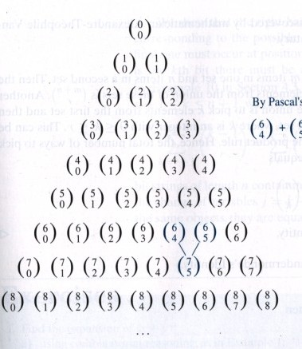
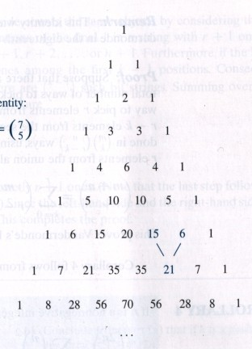
Pascal’s triangle
n = ₀
1
2
3
4
5
6
7
8
1111

Slide 12
Pascal’s Identity
By Pascal’s identity:
⎛ 7 ⎞ ⎛ 6⎞
^{⎛ 6⎞} or 21=15+6
⎜ ⎟ = ⎜ ⎟ + ⎜ ⎟
5 4 5
⎝ ⎠ ⎝ ⎠ ⎝ ⎠
Let n and k be positive integers with n ≥ k.
Then
⎛ n +1⎞ n
⎛ ⎞ ⎛ n ⎞
⎜ ⎟ = ⎜ ⎟ + ⎜ ⎟
⎝ ⎠ ⎝ ^{k −1}⎠ ⎝ ^{k} ⎠
k
■
or C(n+1,k) = C(n,k-1) + C(n,k)
The book calls this Theorem 2 We will prove this via two ways:
■
Combinatorial proof Using the formula for ⎛ ^{n} ⎞
■
⎜ ⎟
k
⎝ ⎠
12

Slide 13
Combinatorial proof of Pascal’s identity
Prove C(n+1,k) = C(n,k-1) + C(n,k) Consider a set T of n+1 elements
■
We want to choose a subset of k elements
We will count the number of subsets of k elements via 2 methods
■
Method 1: There are C(n+1,k) ways to choose such a subset
Method 2: Let a be an element of set T Two cases
■
a is in such a subset
There are C(n,k-1) ways to choose such a subset
a is not in such a subset
There are C(n,k) ways to choose such a subset
■
Thus, there are C(n,k-1) + C(n,k) ways to choose a subset of k
elements
Therefore, C(n+1,k) = C(n,k-1) + C(n,k)
13

Slide 14
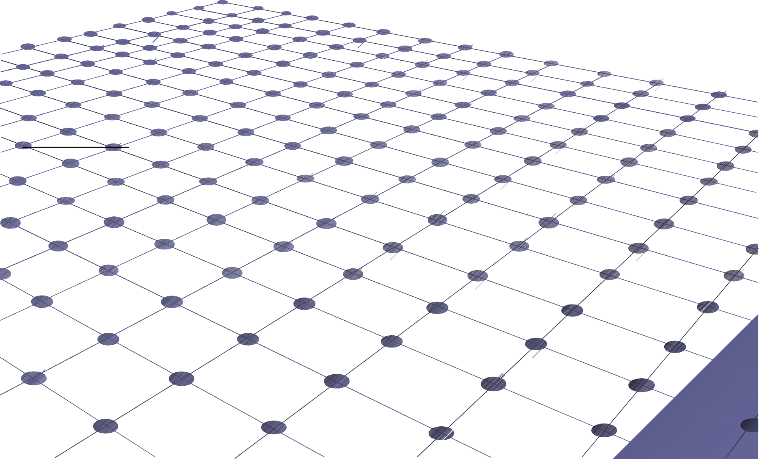
Rosen, section 4.4, question 19: algebraic proof of Pascal’s identity
⎛ n +1⎞ n
⎛ ⎞ ⎛ n ⎞
⎜ ⎟ = ⎜ ⎟ + ⎜ ⎟
⎝ k k −1⎠
⎠ ⎝
⎝ ^{k} ⎠
(n +1)! n!
n!
= +
k!(n +1− k )! (k −1)!(n − (k −1))! k!(n − k )!
(n +1)n! n!
n!
=
+
k (k −1)!(n +1− k )(n − k )! (k −1)!(n − k +1)(n − k )!
k (k −1)!(n − k )!
(n +1) 1 ₊ 1
Substitutions:
(n +1− k )!= (n +1− k )*(n − k )!
(n +1)!= (n +1)n!
(n − k +1) = (n − k +1)(n − k )!
=
k (n +1− k ) (n − k +1) k
(n +1) k ₊ (n − k +1)
=
k (n +1− k ) k (n − k +1) k (n − k +1)
n +1 = k + n − k +1
n +1 = n +1
14

Slide 15
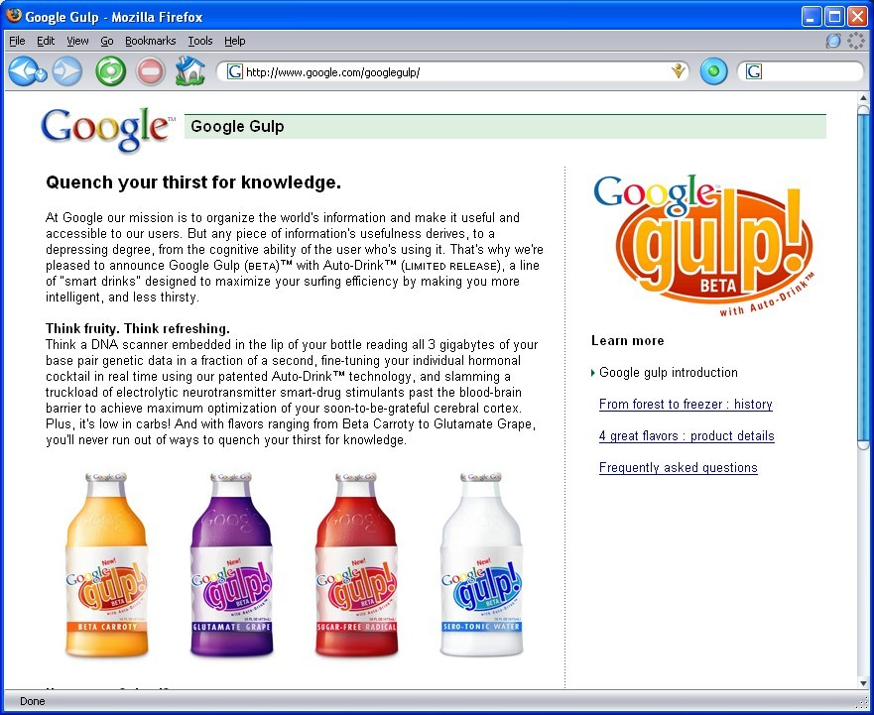
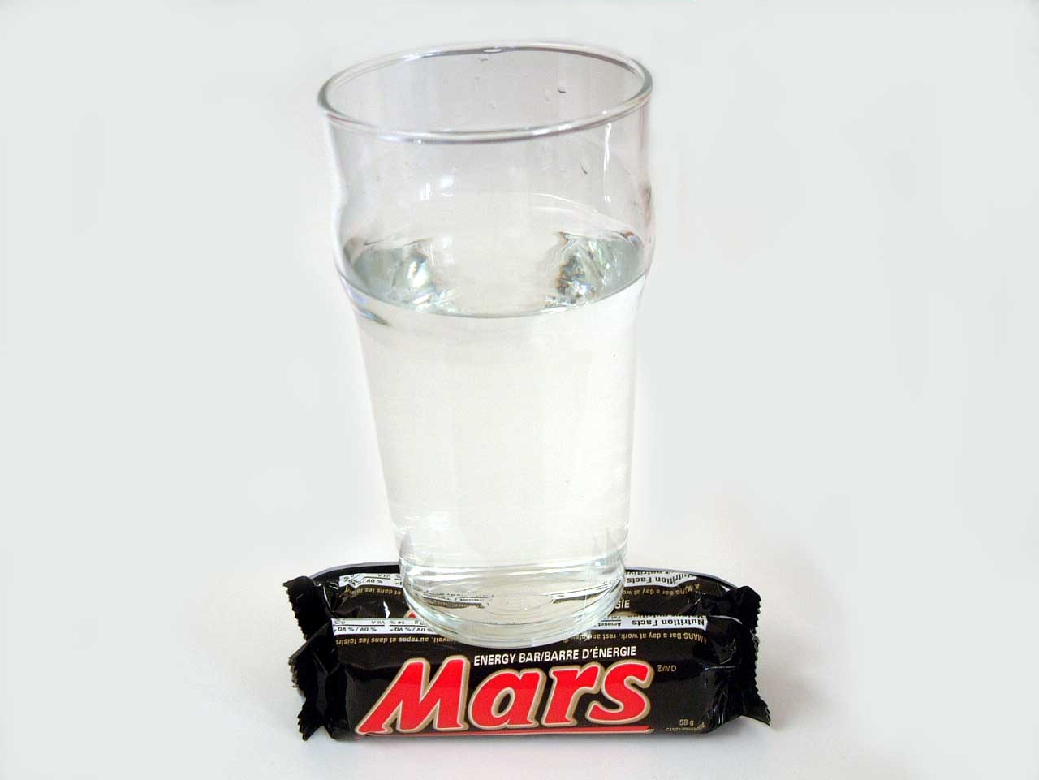
April Fools Day Jokes
PPrriivavaccyy ppoolliicycy
■ FFroromm ttiimeme ttoo ttiimmee,, iinn oorrddeerr ttoo iimpmprrooveve GGooooggllee GGuullpp''ss
uuseseffuullnneessss ffoorr oouurr uusesers,rs, GGooooggllee GGuullpp wwiillll sesenndd ppaackeckettss
ooff ddaattaa rreellaatteedd ttoo yoyouurr uusasaggee ooff tthhiiss pprroodduuctct ffroromm aa wwiirreelleessss ttrarannsmismitttteerr eembmbeeddddeedd iinn tthhee bbaasese ooff yyoouurr
GGooooggllee GGuullpp bboottttllee ttoo tthhee GGuullppPlPleex™,x™, aa hheeaavivillyy gguuaarrddeedd,,
mamassissivevellyy ppaararalllleell seserrvveerr ffaarrmm wwhhoosese lloocacattiioonn iiss knknoowwnn
oonnllyy ttoo EEriricc SSchchmimiddtt,, wwhhoo cacarrrriieess iittss GGPSPS cocooorrddiinnaatteess oonn
aa 6644-b-biitt-e-enncrypcryptteedd smsmaartrt cacardrd lloockeckedd iinn aa ststaaiinnlleess-stss-steeeell bbririeeffccaasese hhaannddccuuffffeedd ttoo hhiiss ririgghhtt wwriristst.. NNoo ppeersorsonnaallllyy
iiddeennttiiffiiaabbllee iinnffoorrmamattiioonn ooff aannyy kikinndd rerellaatteedd ttoo yyoouurr
coconnsusummppttiioonn ooff GGooooggllee GGuullpp oorr aannyy ootthheerr cucurrrerenntt oorr
ffuuttuurere GGooooggllee FFooooddss pprorodduuctct wwiillll eeveverr bbee ggiivevenn,, sosolldd,,
bbaartrteereredd,, aauuctctiioonneedd ooffff,, ttoossessedd iinnttoo aa llaattee-n-niigghhtt ppookekerr
ppoott,, oorr ootthheerwrwiisese ttrraannsfsfeerrerredd iinn aannyy wwaayy ttoo aannyy uunnttrruuststwwoorrtthhyy tthhiirrdd ppaartrty,y, eevever,r, wwee swsweeaar.r. SSeeee oouurr PPrriivvaacycy PoPolliicy.cy. 1155
http://www.google.com/googlegulp/ (or do a Google search for ‘gulp’)

Slide 16
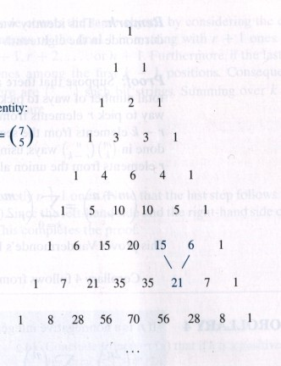
Pascal’s triangle
n =
0 | sum = ₁
1 | 2
2 | 4
3 | 8
4 | 16
5 | 32
6 | 64
7 | 128
8 | 256
= 2^{n}

Slide 17
Proof practice: corollary 1
Let n be a non-negative integer. Then
n
⎛ n ⎞
∑
⎜ ⎟ = 2
n
k
k =0 ⎝ ⎠
Algebraic proof
2^{n} = (1+1)^{n}
n
⎛ n ⎞
n
∑
n− j j
(x + y) =
⎜ ⎟x
y
j
j =0 ⎝ ⎠
n
⎛ n ⎞
=
∑
⎜ ⎟1 1
k n−k
k
k =0 ⎝ ⎠
n
⎛ n ⎞
=
∑
⎜ ⎟
k
k =0 ⎝ ⎠

Slide 18
Proof practice: corollary 1
Let n be a non-negative integer. Then
n
⎛ n ⎞
∑
⎜ ⎟ = 2
n
k
k =0 ⎝ ⎠
Combinatorial proof
A set with n elements has 2^{n} subsets
By definition of power set
Each subset has either 0 or 1 or 2 or … or n elements
■
■
There are
⎛ n ⎞ ⎛ n ⎞
⎜ ⎟
0
subsets with 0 elements, subsets with 1
⎜ ⎟
1
⎝ ⎠
⎛ n ⎞
⎝ ⎠
element, … and
⎜ ⎟
subsets with n elements
n
⎝ ⎠
n
⎛ n ⎞
Thus, the total number of subsets is
∑⎜ ⎟
Thus, ⎛ n ⎞
■
n
k =0 ⎝ ^{k} ⎠
∑
⎜ ⎟ = 2
n
k
k =0 ⎝ ⎠

Slide 19
Pascal’s triangle
n = ₀
1
2
3
4
5
6
7
8
20

Slide 20
Proof practice: corollary 2
n
Let n be a positive integer. Then ∑
_{k} ⎛ n ⎞
(−1) ⎜ ⎟ = 0
k
Algebraic proof
k =0
⎝ ⎠
0 = 0^{n}
= ((−1) +1)^{n}
n
⎛ n ⎞
=
∑
k n−k
⎜ ⎟(−1) 1
k
k =0 ⎝ ⎠
n
⎛ n ⎞
=
∑
⎜ ⎟(−1)
k
k
k =0 ⎝ ⎠
This implies that
⎛ n ⎞ ⎛ n ⎞ ⎛ n ⎞ ⎛ n ⎞ ⎛ n ⎞ ⎛ n ⎞
⎜ ⎟ + ⎜ ⎟ + ⎜ ⎟ +☹ = ⎜ ⎟ + ⎜ ⎟ + ⎜ ⎟ +☹
0 2 4 1 3 5
⎝
⎠
⎝
⎠
⎝
⎠
⎝
⎠
⎝
⎠
⎝
⎠

Slide 21
Proof practice: corollary 3
Let n be a non-negative integer. Then
n
_{k} ⎛ n ⎞
∑
k =0
2 ⎜ ⎟ = 3
n
k
⎝ ⎠
Algebraic proof
3^{n} = (1+ 2)^{n}
n
⎛ n ⎞
=
∑
n−k k
⎜ ⎟1 2
k
k =0 ⎝ ⎠
n
⎛ n ⎞
=
∑
⎜ ⎟2
k
k
k =0 ⎝ ⎠

Slide 22
Vandermonde’s identity
Let m, n, and r be non-negative integers with r not exceeding either m or n. Then
⎛ m + n ⎞
r
⎛ m ⎞⎛ n ⎞
⎜
⎝
∑
⎟ = ⎜ ⎟⎜ ⎟
⎠ ^{k} ⎠⎝ ^{k} ⎠
r
k =0 ⎝
r −
The book calls this Theorem 3

Slide 23
Combinatorial proof of Vandermonde’s identity
Consider two sets, one with m items and one with n
items
Then there are ⎜ ⎟ ways to choose r items from the union of those two sets ⎝ ⎠
■
⎛ m + n ⎞
r
Next, we’ll find that value via a different means
■
Pick k elements from the set with n elements
Pick the remaining r-k elements from the set with m elements
■
■
Via the product rule, there are value of k
⎛ m ⎞⎛ n ⎞
⎟ ways to do that for EACH
⎜ ⎟⎜
r −
⎝ ^{k} ⎠⎝ ^{k} ⎠
r
⎛ m ⎞⎛ n ⎞
∑⎜
■
Lastly, consider this for all values of k:
⎟⎜ ⎟
_{k =0 ⎝} r − k ⎠⎝ k ⎠
⎛ m + n ⎞
r
⎛ m ⎞⎛ n ⎞
Thus, ⎜
⎝
∑
⎟ = ⎜ ⎟⎜ ⎟
⎠ ^{k} ⎠⎝ ^{k} ⎠
r
k =0 ⎝
r −

Slide 24
Review of Rosen, section 4.3, question 11 (a)
How many bit strings of length 10
contain
exactly four 1’s?
Find the positions of the four 1’s
The order of those positions does not matter
Positions 2, 3, 5, 7 is the same as positions 7, 5, 3, 2
Thus, the answer is C(10,4) = 210
■
■
■
Generalization of this result:
■
There are C(n,r) possibilities of bit strings of length n
containing r ones

Slide 25
Yet another combinatorial proof
Let n and r be non-negative integers with r ≤ n.
Then
⎛ n +1⎞
n
⎛ j ⎞
⎜ ⎟ =
⎝ ⎠
∑
⎜ ⎟
r +1
r
j =r ⎝ ⎠
■
The book calls this Theorem 4
We will do the combinatorial proof by showing that both sides show the ways to count bit strings of length n+1 with r+1 ones
From previous slide: ^{⎛ n +1⎞} achieves this
⎜ ⎟
r +1
⎝ ⎠

Slide 26
Yet another combinatorial proof
Next, show the right side counts the same objects
The final one must occur at position r+1 or r+2 or … or
n+1
Assume that it occurs at the k^{th} bit, where r+1 ≤ k ≤ n+1
■
Thus, there must be r ones in the first k-1 positions
Thus, there are
⎛ k −1⎞
such strings of length k-1
■
⎜ ⎟
r
⎝ ⎠
As k can be any value from r+1 to n+1, the total number of possibilities is
n+1
⎛ k −1⎞
n
⎛ k ⎞ ⎛ j ⎞
∑ ⎜
∑
n
⎟ =
⎠
⎜ ⎟
=
∑
⎜ ⎟
k =r +1 ⎝
r
r
r
k =r ⎝ ⎠
j =r ⎝ ⎠
Thus,
⎛ n +1⎞
n
⎛ j ⎞
⎜ ⎟ =
⎝ ⎠
∑
⎜ ⎟
r +1
r
j =r ⎝ ⎠

Slide 27
Rosen, section 4.4, question 24
Show that if p is a prime and k is an integer such that
1 ≤ k ≤ p-1, then p divides
⎛ p ⎞
⎜ ⎟
k
⎝ ⎠
We know that
⎛ p ⎞ p!
⎜ ⎟ =
k k!( p − k )!
⎝ ⎠
p divides the numerator (p!) once only
■
Because p is prime, it does not have any factors less than p
We
need to show that it does NOT divide the
denominator
■
Otherwise the p factor would cancel out
Since k < p (it was given that k ≤ p-1), p cannot divide k!
Since k ≥ 1, we know that p-k < p, and thus p cannot divide (p-k)!
Thus, p divides the numerator but not the denominator
Thus, p divides
⎛ p ⎞
⎜ ⎟
k
⎝ ⎠

Slide 28
Rosen, section 4.4, question 38
Give a combinatorial proof that if n is positive
integer then
n
₂ ⎛ n ⎞
∑
k ⎜ ⎟ = n(n +1)2
n−2
k
k =0
⎝ ⎠
Provided hint: show that both sides count the ways to select a subset of a set of n elements together with two not necessarily distinct elements from the subset
Following the other provided hint, we express
the right side as follows:
n
₂ ⎛ n ⎞
∑
k =0
k ⎜ ⎟ = n(n −1)2
n−2 n−1
n2
k
⎝ ⎠

Slide 29
Rosen, section 4.4, question 38
Show the left side properly counts the desired property
n
₂ ⎛ n ⎞
Consider each of the possible subset sizes k
∑
k =0
k ⎜ ⎟ = ☹
k
⎝ ⎠
Choosing a subset of k elements from a set of n elements
Choosing one of the k elements in the subset twice

Slide 30

Rosen, section 4.4, question 38
Two cases to show the right side: n(n-1)2^{n-2}+n2^{n-1}
■
Pick the same element from the subset
Pick that one element from the set of n elements: total of n possibilities Pick the rest of the subset
As there are n-1 elements left, there are a total of 2^{n-1} possibilities to pick a given subset
We have to do both
■
■
Thus, by the product rule, the total possibilities is the product of the two Thus, the total possibilities is n*2^{n-1}
■
■
Pick different elements from the subset
Pick the first element from the set of n elements: total of n possibilities Pick the next element from the set of n-1 elements: total of n-1 possibilities Pick the rest of the subset
As there are n-2 elements left, there are a total of 2^{n-2} possibilities to pick a given subset
We have to do all three
■
■
Thus, by the product rule, the total possibilities is the product of the three Thus, the total possibilities is n*(n-1)*2^{n-2}
■
■
We do one or the other
Thus, via the sum rule, the total possibilities is the sum of the two Or n*2^{n-1}+n*(n-1)*2^{n-2}

Slide 31


Quick survey
I felt I understood the material in this slide set…
a) Very well
■
With some review, I’ll be good
Not really
Not at all

Slide 32
Quick survey
The pace of the lecture for this slide set was…
a) Fast
■
About right
A little slow
Too slow

Slide 33
Quick survey
■
How interesting was the material in this slide set? Be honest!
Wow! That was SOOOOOO cool!
Somewhat interesting
Rather borting
Zzzzzzzzzzz

Slide 34
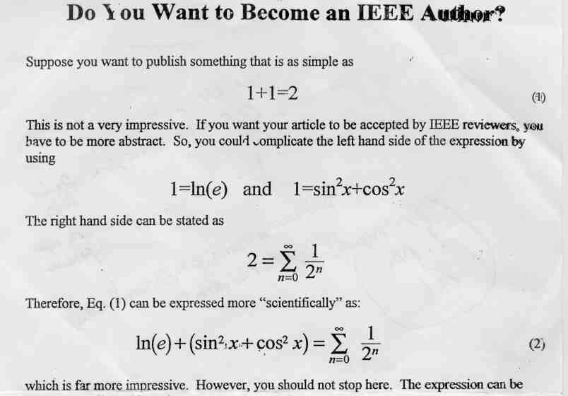
Becoming an IEEE author

